Slide 1
End-to-end deep learning for pTX

Slide 2
End-to-end deep learning for pTX
Input
Single-slice image from 1-ch Tx / pTx with CP mode
B1 map, B0 map
Output
Single-slice image from pTx with spokes
Neural network
U-net, train the residual instead of the image
Training
Multi-slice, multi-direction images
Patch-based?
Julia or Python?

Slide 3
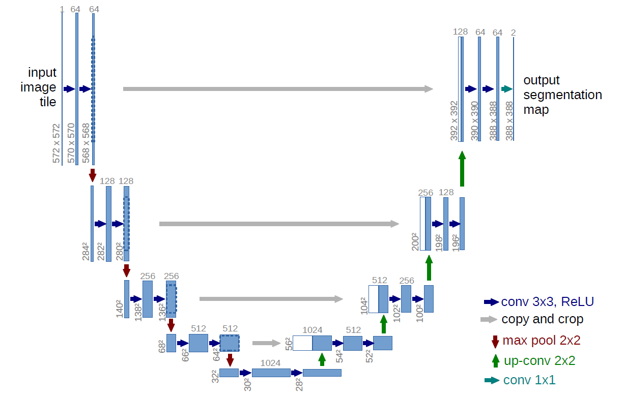
U-net

Slide 4
Training and testing
Data processing
7 volumes (1 b0 + 6 directions), 100 slice, 5 subjects
Downsampled to 128x128 using Matlab (cubic interpolation)
Scaled to 0 to 1
4 subjects for training (N=7x100x4=2800)
10 epochs, mini-batch size=10
Training time ~ 3 days
1 subject for testing (N=7*100=700)

Slide 5
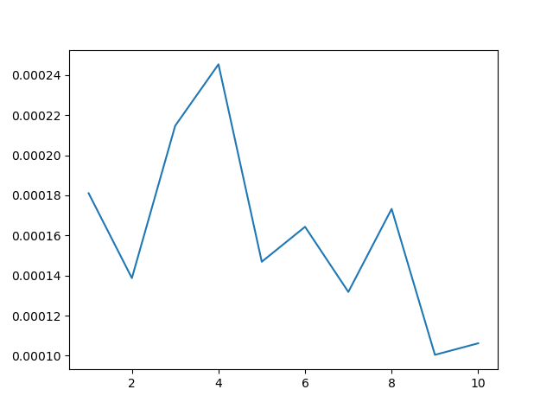
MSE Loss function with testing data

Slide 6
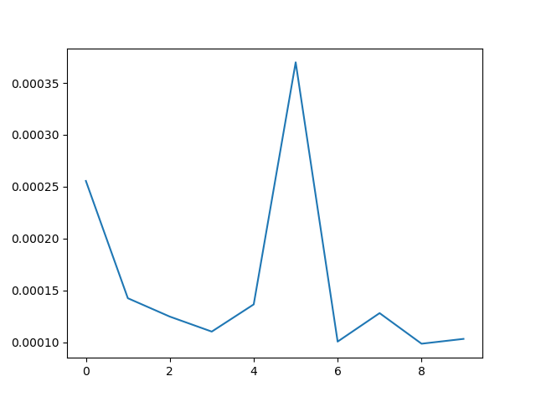
MSE Loss function with testing data (gpu)

Slide 7
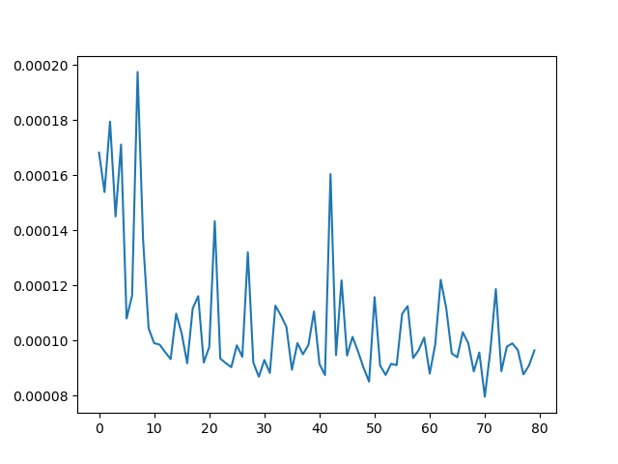
MSE Loss function with testing data (gpu+T1w)

Slide 8
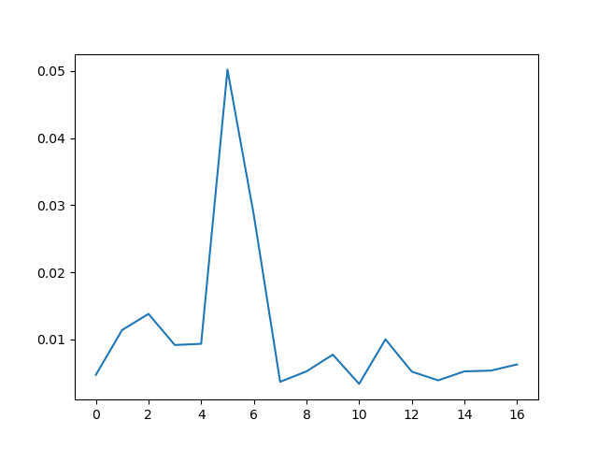
L1 Loss function with testing data (gpu)

Slide 9
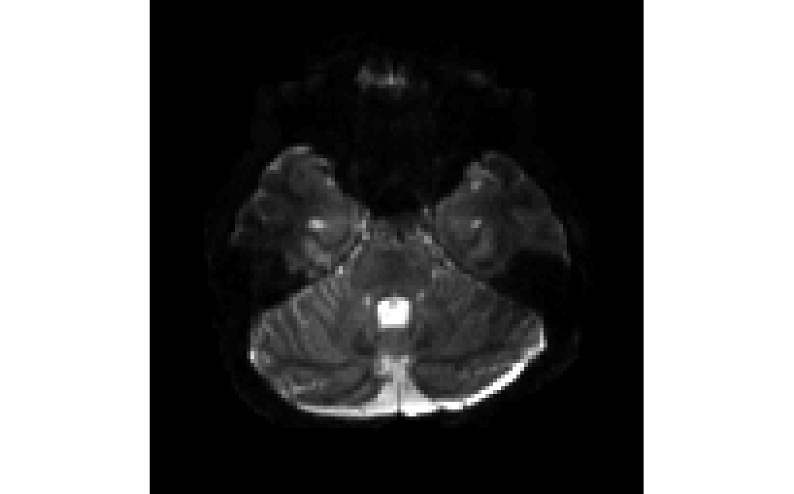
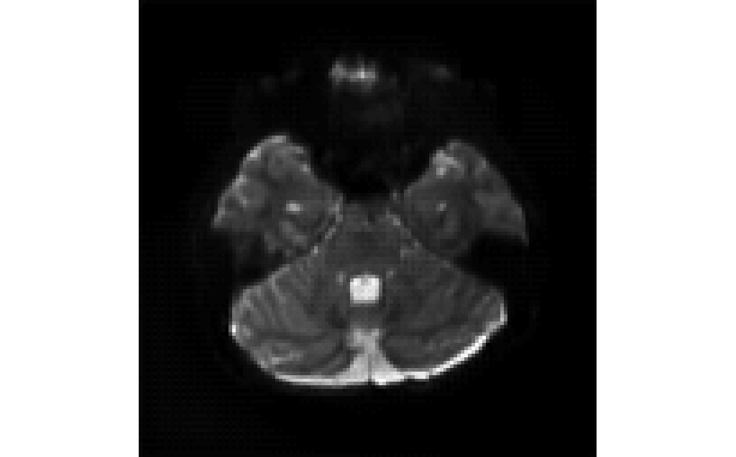
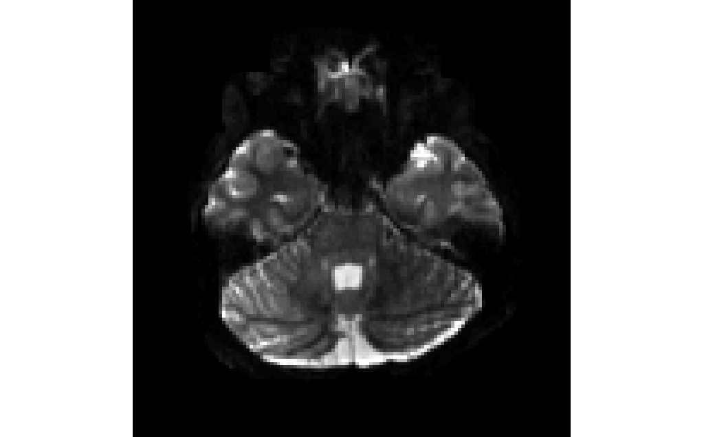
1TX
uNet (10 epochs)
pTX

Slide 10
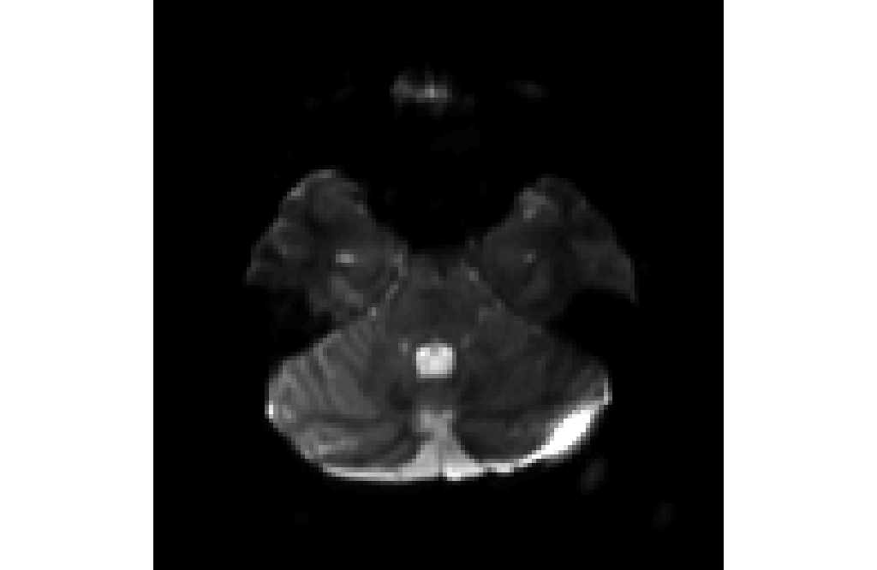
L1 loss
1TX
uNet (10 epochs)
pTX

Slide 11
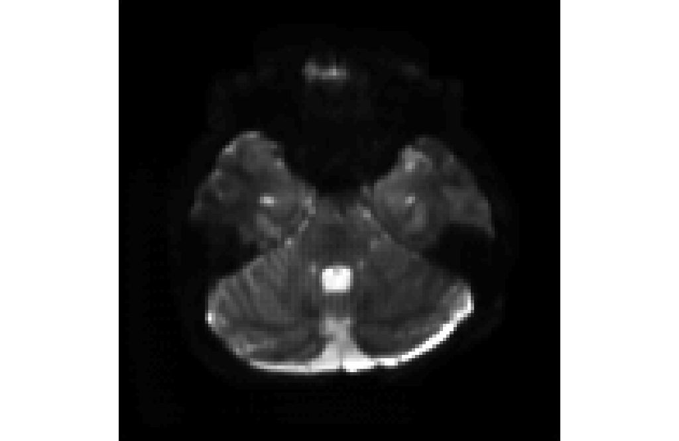
With T1w as input channels
1TX
uNet (10 epochs)
pTX

Slide 12
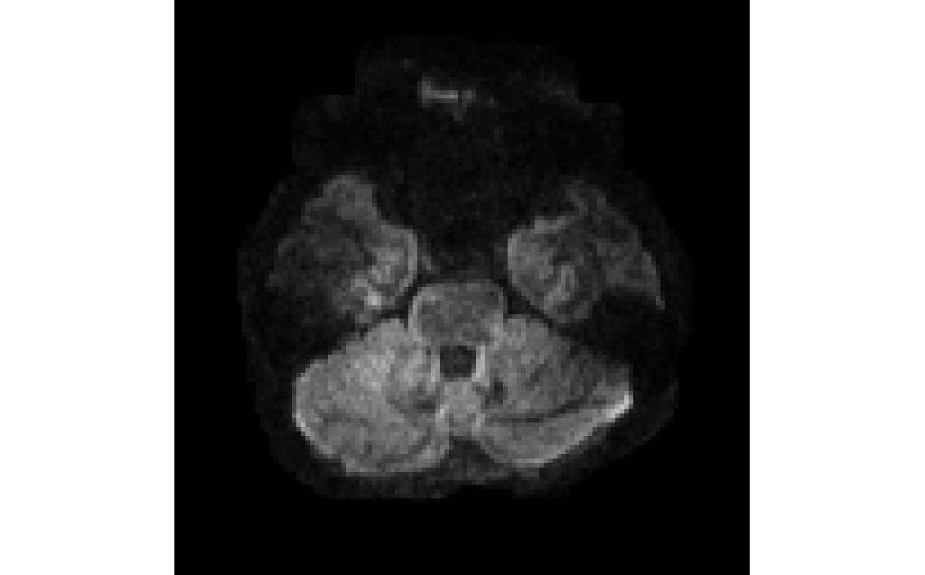
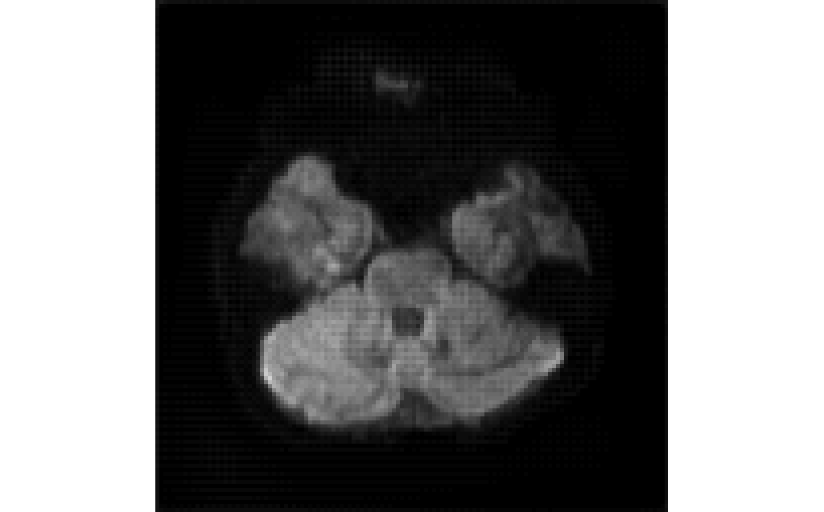
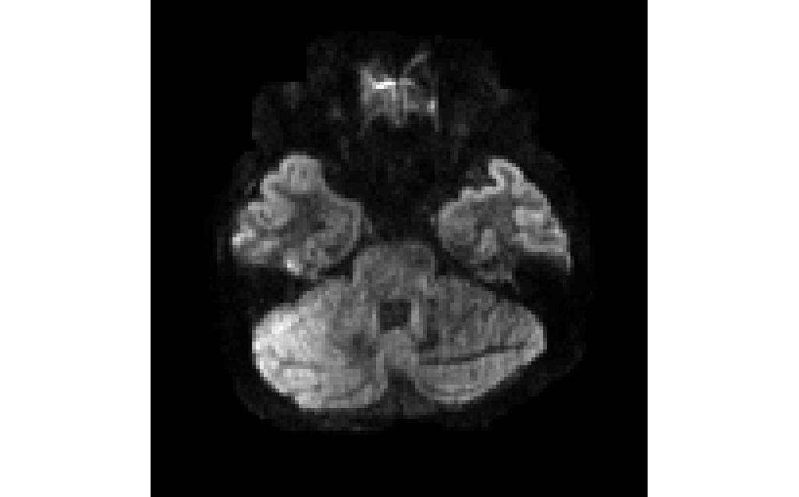
1TX
uNet (10 epochs)
pTX

Slide 13
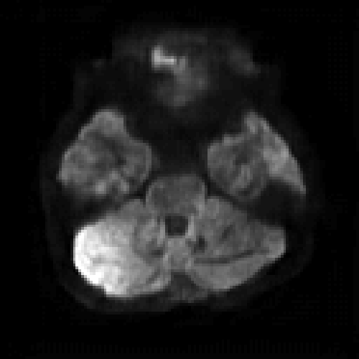
ResNet
1TX
ResNet (10 epochs)
pTX

Slide 14
1TX
uNet
ResNet
pTX

Slide 15
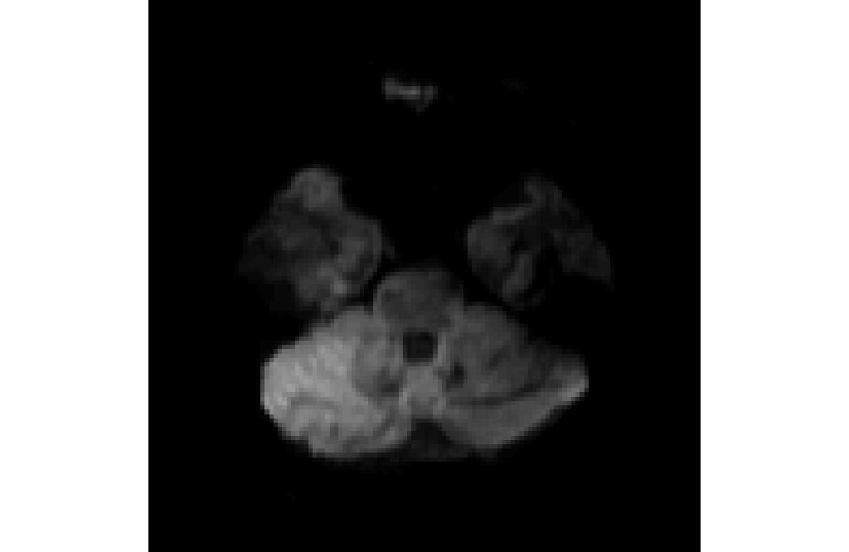
L1 loss
1TX
uNet (10 epochs)
pTX

Slide 16
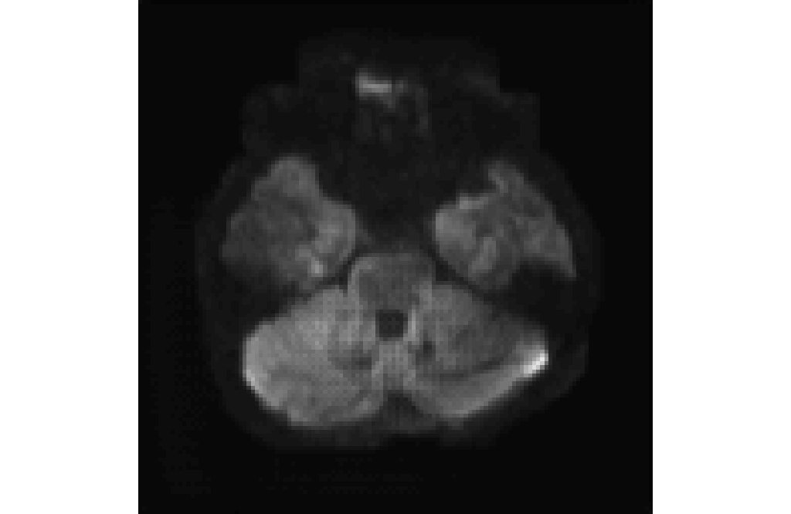
With T1w as input channels
1TX
uNet (10 epochs)
pTX

Slide 17
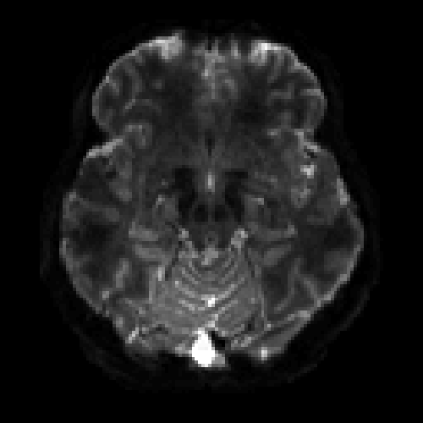
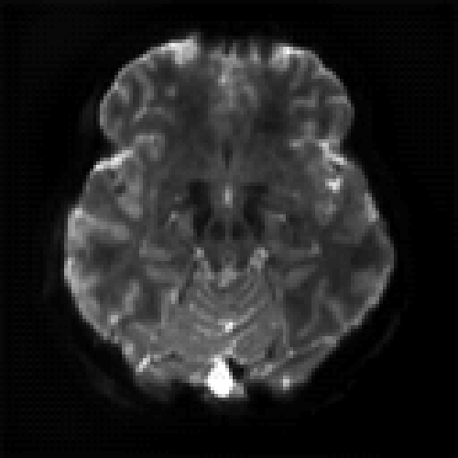
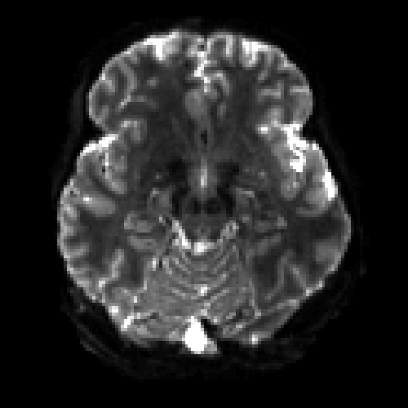
1TX
uNet (10 epochs)
pTX

Slide 18
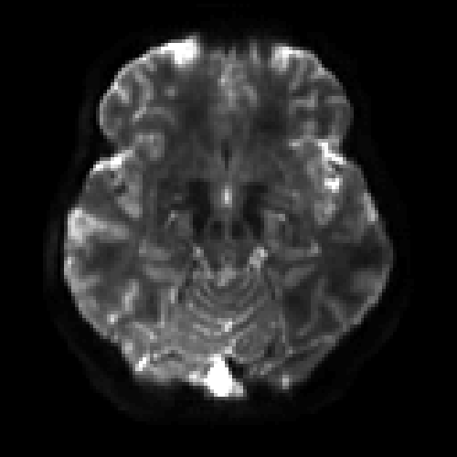
ResNet
1TX
ResNet (10 epochs)
pTX

Slide 19
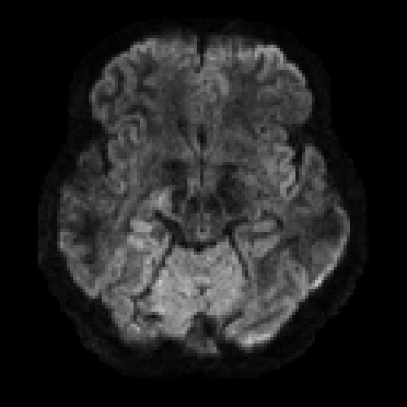
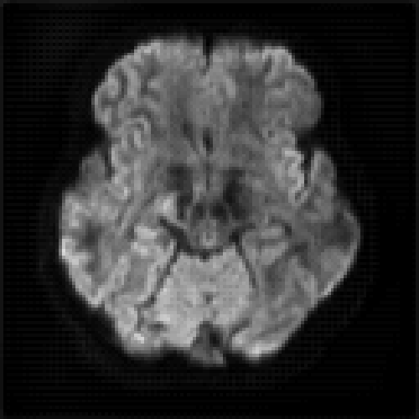
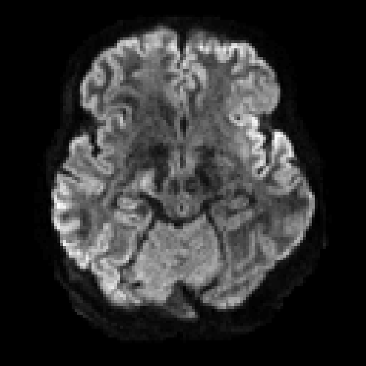
1TX
uNet (10 epochs)
pTX

Slide 20
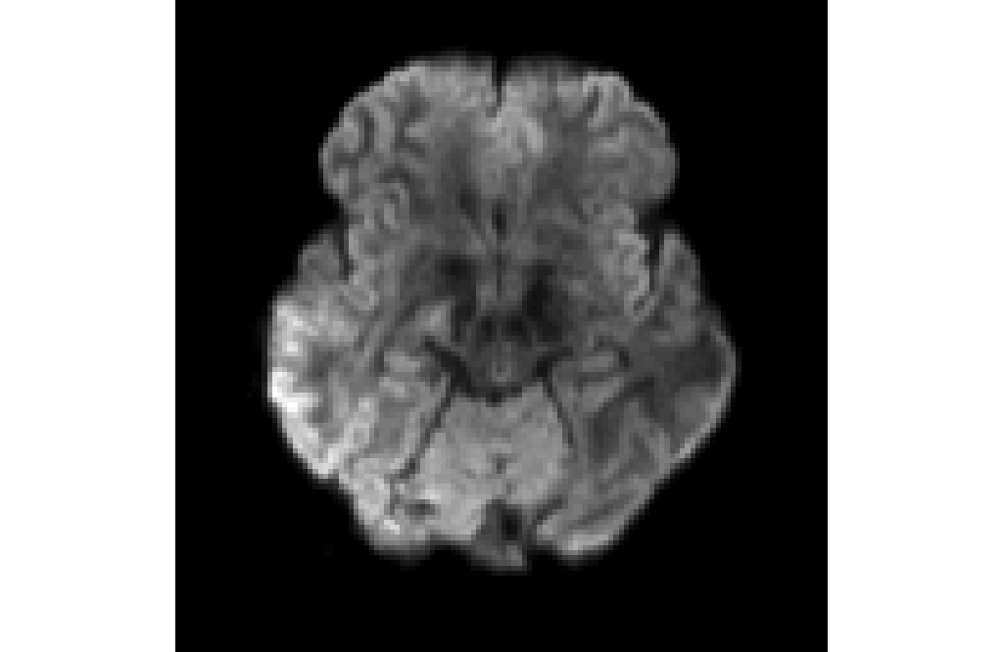
With GPU
1TX
uNet (10 epochs)
pTX

Slide 21
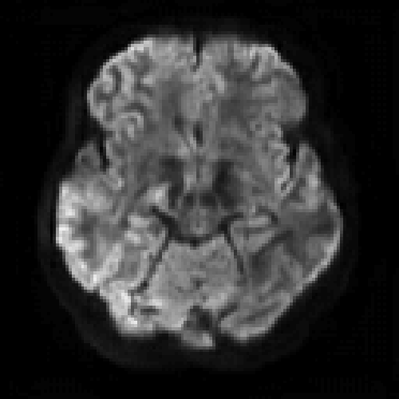
ResNet
1TX
ResNet (100 epochs)
pTX

Slide 22
1TX
UNet
ResNet
pTX

Slide 23
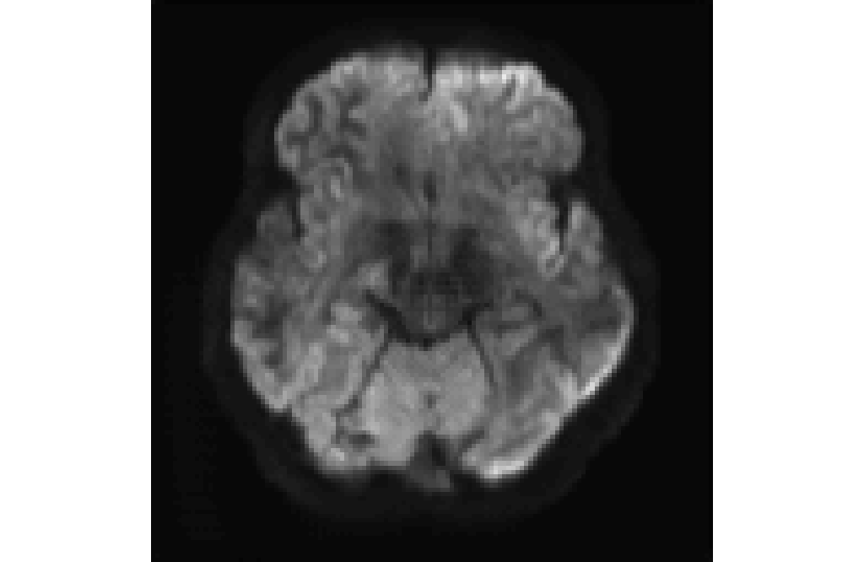
With T1w as input channels
1TX
uNet (10 epochs)
pTX

Slide 24
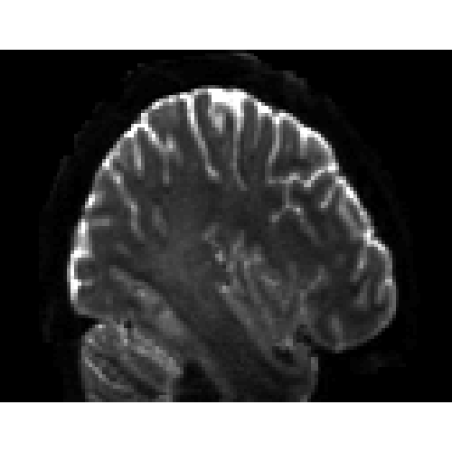
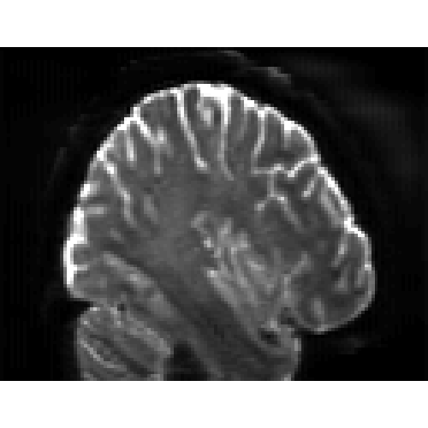
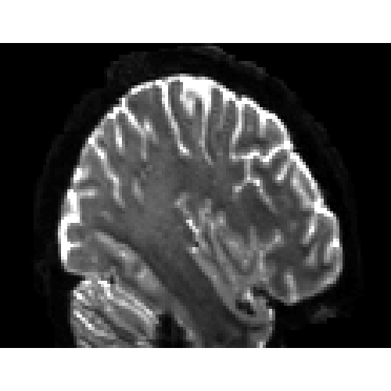
1TX
uNet (10 epochs)
pTX

Slide 25
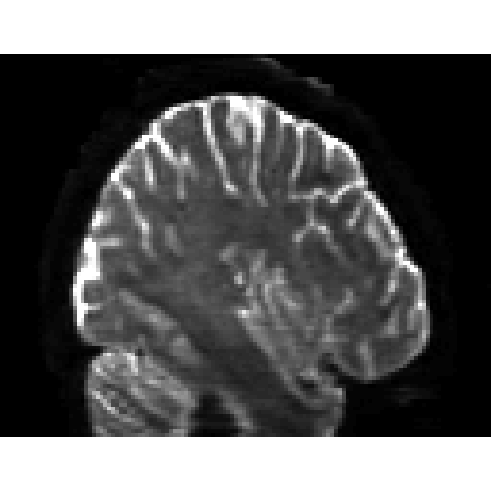
1TX
ResNet (100 epochs)
pTX

Slide 26
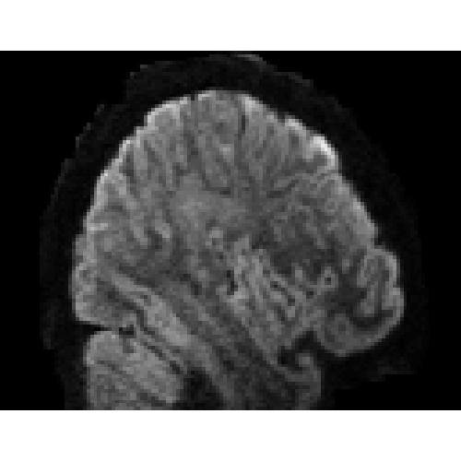
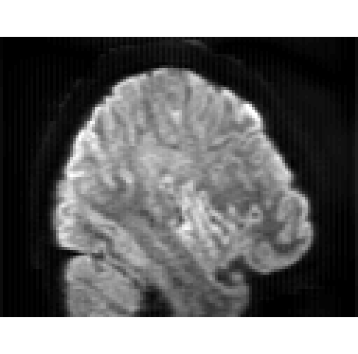
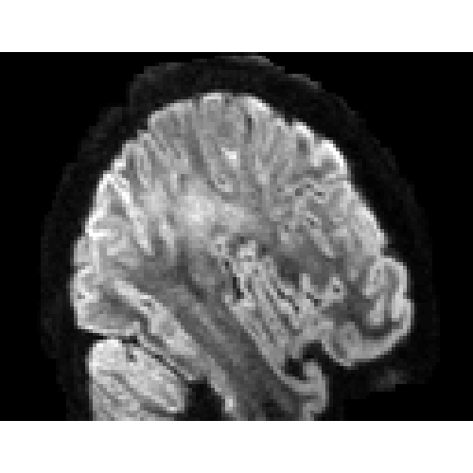
1TX
uNet (10 epochs)
pTX

Slide 27
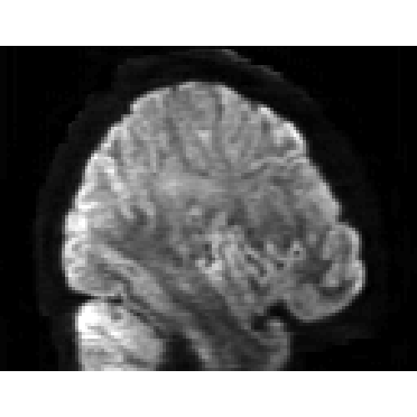
1TX
ResNet (100 epochs)
pTX

Slide 28
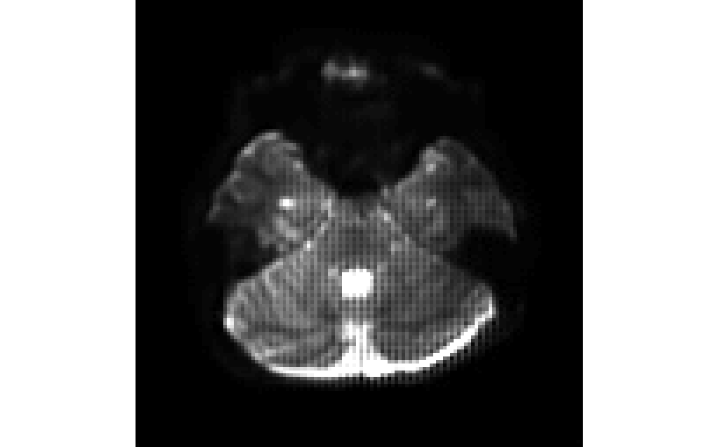
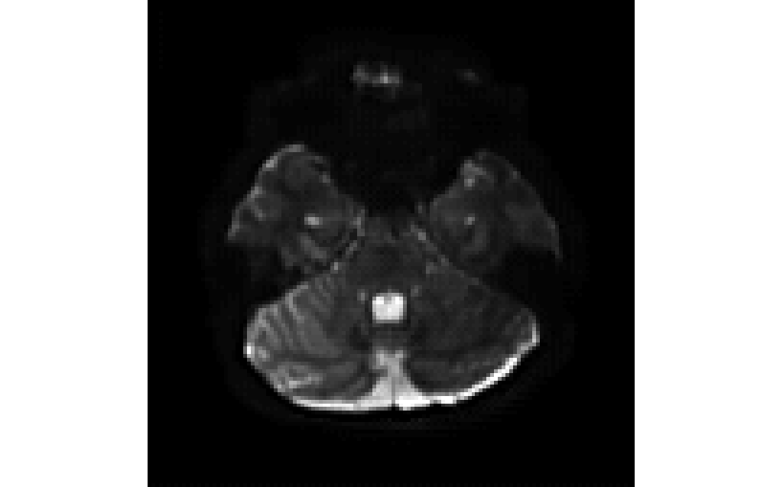
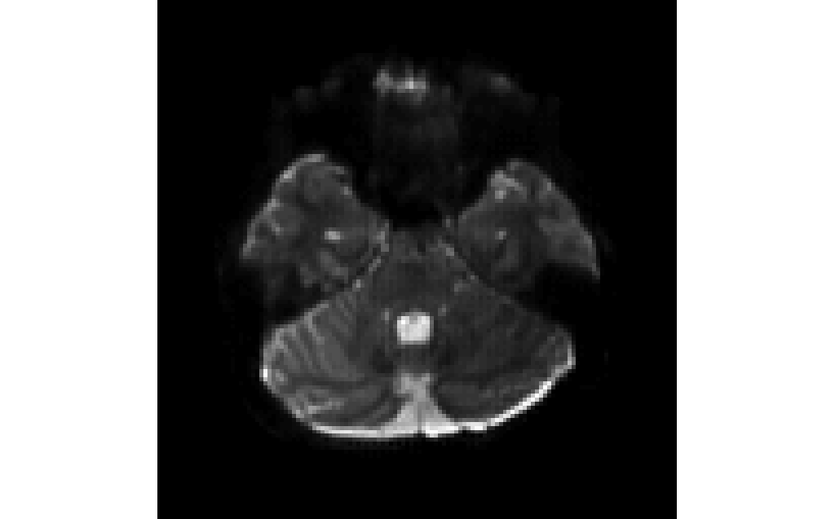
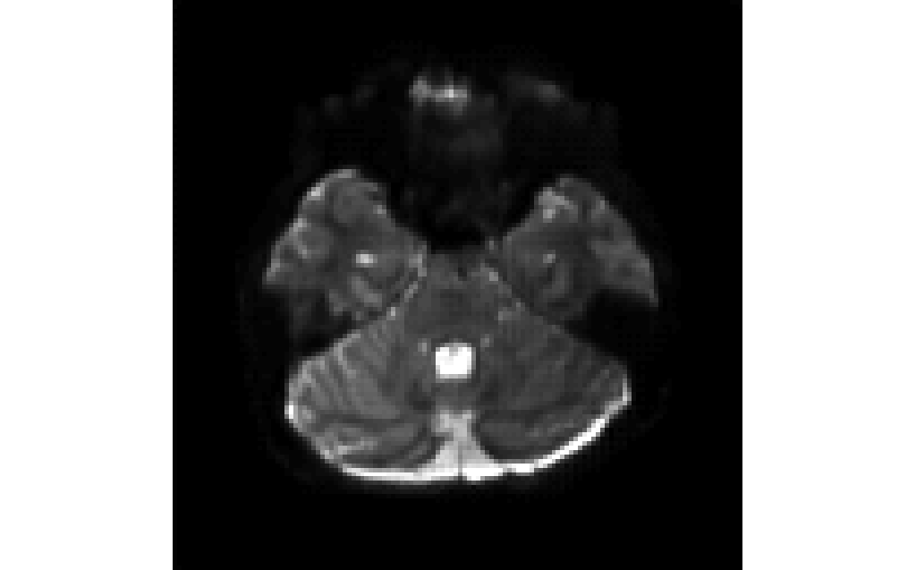
Epoch 1
Epoch 5
Epoch 7
Epoch 9
Epoch 10
Original

Slide 29
Epoch 1
Epoch 5
Epoch 7
Epoch 9
Epoch 10
pTX

Slide 30
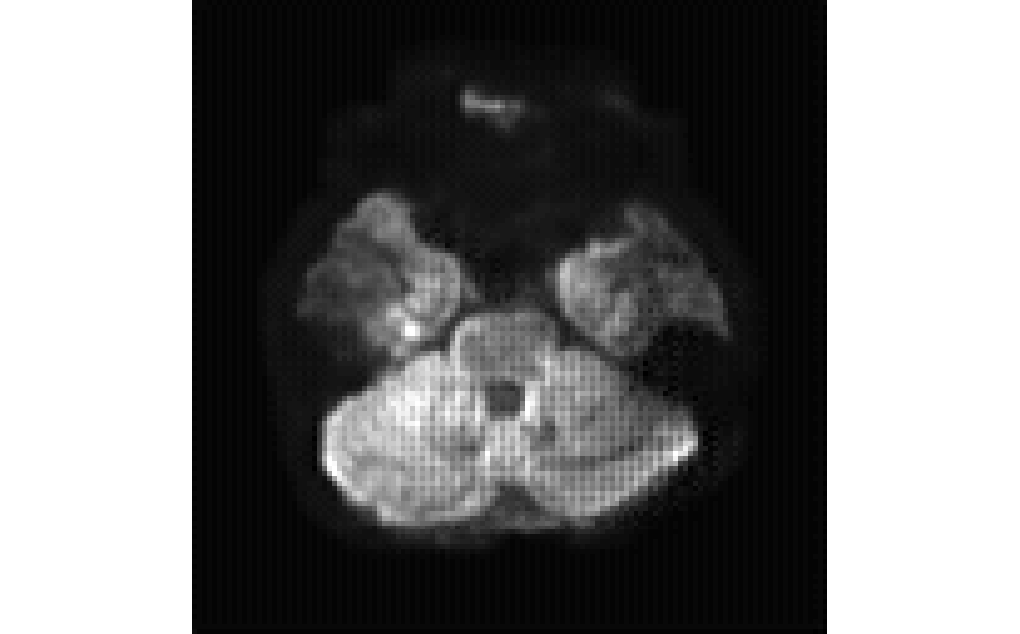
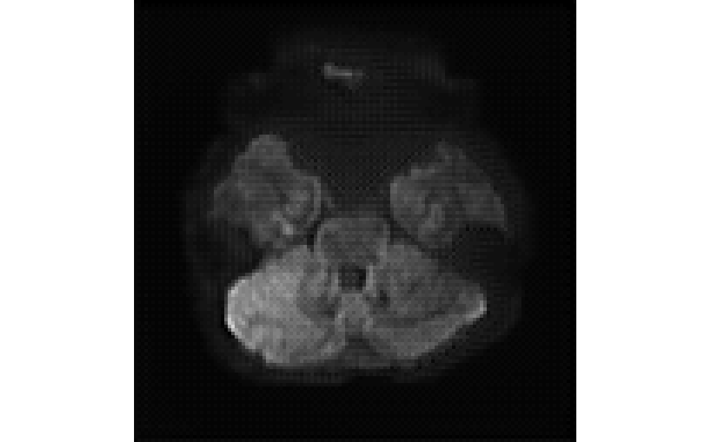
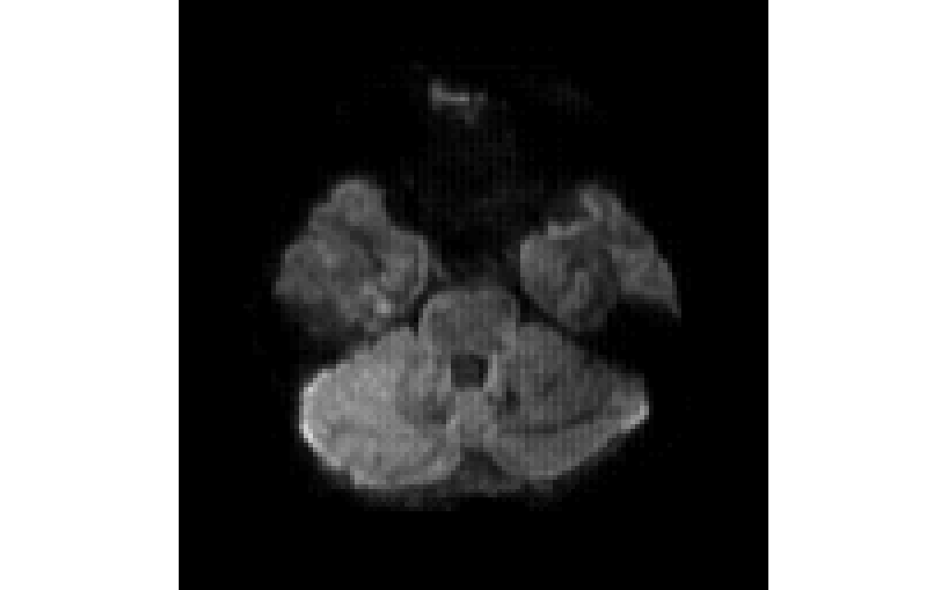
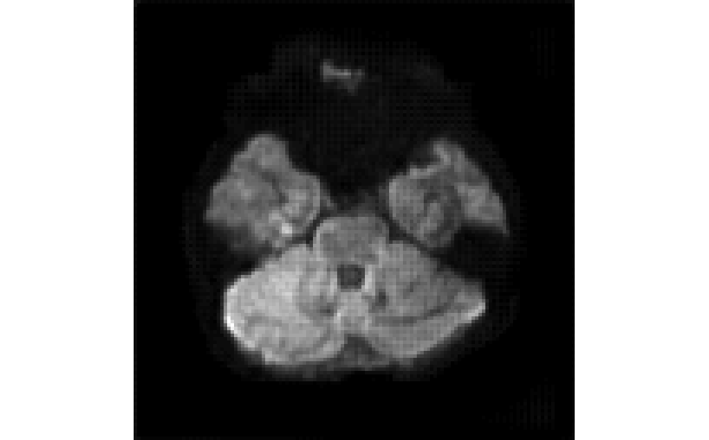
Epoch 1
Epoch 5
Epoch 7
Epoch 9
Epoch 10
Original

Slide 31
Epoch 1
Epoch 5
Epoch 7
Epoch 9
Epoch 10
pTX

Slide 32
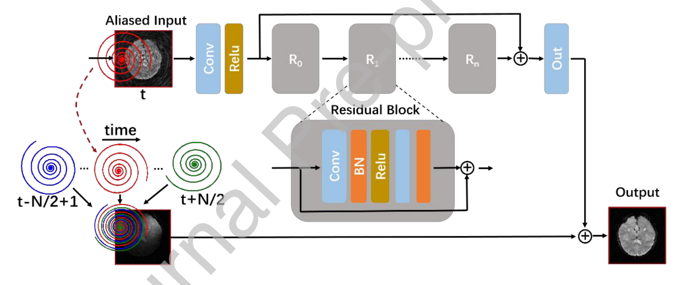
ResNet

Slide 33
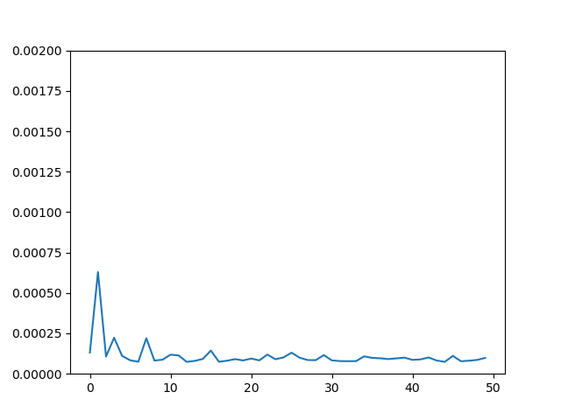
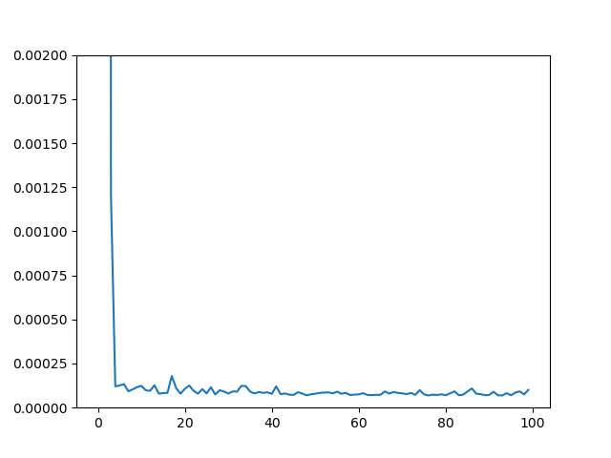
UNet vs. ResNet (Nblock=4)
50 epochs
UNet
ResNet

Slide 34
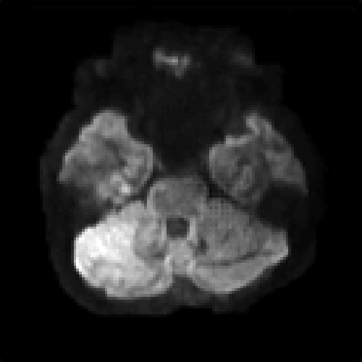
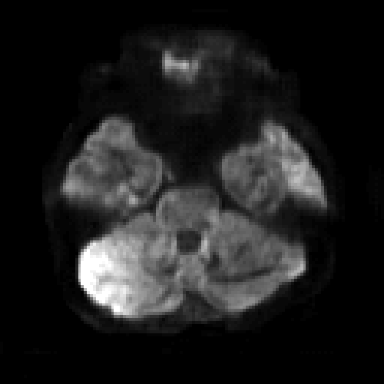
1TX
uNet
ResNet
pTX

Slide 35
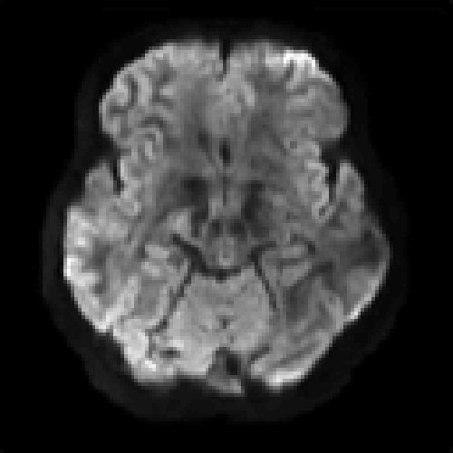
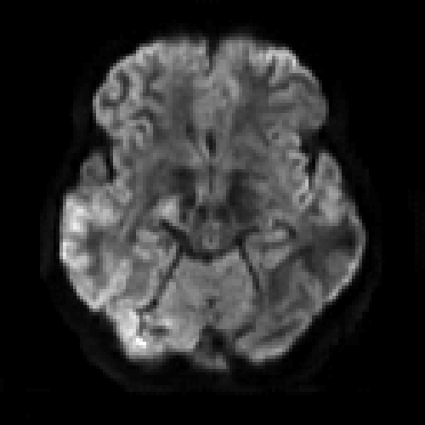
ResNet seems sharper
1TX
UNet
ResNet
pTX
Notes:
2D -> 3D learning?

Slide 36
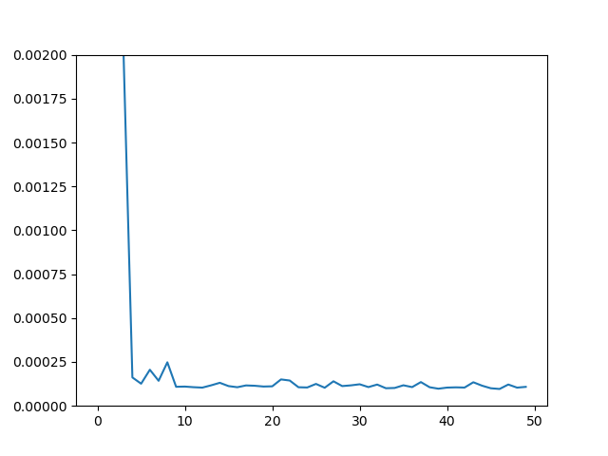
ResNet w and w/o T1W as input
w/o T1W
w T1W

Slide 37

With T1 looks blurry overall but has enhanced structures in some local regions.
Needs more comparison.
1TX
ResNet-7Vol
ResNet-7Vol-T1W
pTX

Slide 38

1TX
ResNet-7Vol
ResNet-7Vol-T1W
pTX

Slide 39
ResNet 7 volumes vs. 71 volumes
Note: The 7-volume or 71-volume case actually contains both b1000 and b2000 because of my mistake.
100 epochs

Slide 40

b =1000
1TX
ResNet-7Vol
ResNet-71Vol
pTX

Slide 41

b =1000
71 volumes has higher SNR and more blurry contrast for b1000
1TX
ResNet-7Vol
ResNet-71Vol
pTX

Slide 42

b =1000
1TX
ResNet-7Vol
ResNet-71Vol
pTX

Slide 43

b =1000
1TX
ResNet-7Vol
ResNet-71Vol
pTX

Slide 44




b =2000
1TX
ResNet-7Vol
ResNet-71Vol
pTX

Slide 45




b =2000
71 volumes has shaper edges than 7 volumes for b2000
1TX
ResNet-7Vol
ResNet-71Vol
pTX

Slide 46
NN parameters
How many layers?
Kernel size? (3x3, 5x5, or 7x7)
Loss function (L1, L2, SSIM, Gradient, etc)
Mini-batch size, learning rate
Notes:
Cross-Validation

Slide 47
Stage 1 : Select basic model configuration
With T1w or without T1w
Loss function
Regularization
Based on roughly visual comparison

Slide 48



b =1000
1TX
ResNet-79Vol w T1W
pTX

Slide 49

b =1000
1TX
ResNet-79Vol w T1W
pTX

Slide 50
No T1W, L2
1TX
ResNet-79Vol w T1W
pTX

Slide 51
b =1000
1TX
ResNet-79Vol w T1W
pTX

Slide 52






b =1000
1TX
pTX
DL-L1
DL-L2

Slide 53





b =1000
1TX
pTX
DL-L1
DL-L2

Slide 54





b =1000
1TX
pTX
DL-L1
DL-L2

Slide 55





b =1000
1TX
pTX
DL-L1
DL-L2

Slide 56

1TX, dir1

Slide 57

L2-residual, dir1

Slide 58

L1-residual, dir1

Slide 59

L1-residual, dir1, T1W

Slide 60

L1-residual, dir1, 20 epochs

Slide 61

pTX, dir1

Slide 62

L1, dir1

Slide 63

L2, dir1

Slide 64

1TX, dir2

Slide 65

L2-residual, dir2

Slide 66

L1-residual, dir2

Slide 67

L1-residual, dir2, T1W

Slide 68

L1-residual, dir2, T1W, UNet

Slide 69

L1-residual, dir2, 20 epochs

Slide 70

pTX, dir2

Slide 71

L1, dir2

Slide 72

L2, dir2

Slide 73

1TX, dir3

Slide 74

L2-residual, dir3

Slide 75

pTX, dir3

Slide 76

L1, dir3

Slide 77

L2, dir3

Slide 78
L2-residual, dir3

Slide 79

1TX

Slide 80

DL, L2-residual

Slide 81

DL, L1-residual
Notes:
Location: 128,124,6

Slide 82

DL, L1-residual, 20 epochs
Notes:
Location: 128,124,6

Slide 83

pTX

Slide 84

L2

Slide 85
1TX
L2-residual
L1-residual
pTX

Slide 86
1TX
L2-residual
pTX

Slide 87

1TX
L2-residual-T1W
pTX

Slide 88
1TX
L1-residual
pTX

Slide 89

1TX
L1-residual-T1W
pTX

Slide 90
1TX
L1-residual-20epoch
pTX

Slide 92
Stage 2 : Select neural network type
ResNet vs. Unet
Based on quantitative 5-fold cross-validation

Slide 93
Stage 3 : Hyperparameter tuning
Number of hidden layers
Convolution kernel
Number of features (expanded channels, for ResNet)
Mini-batch size
Initial learning rate
Learning rate decay factor
Based on quantitative nested cross-validation using random search

